Slide 1
EEG Source Localization Algorithm based on 3D-Grid Source Model
Qinyuan (David) Wei
Supervisor: Nicole Zhou
Mentor: Wentai Liu
Date: 08/31/2017

Slide 2
Outline
MCE
sLORETA & LCMV
Results & analysis
Conclusions
Notes:
This is the outline of my presentation. In the past several weeks, I tested several methods and draw some conclusion about it.

Slide 3
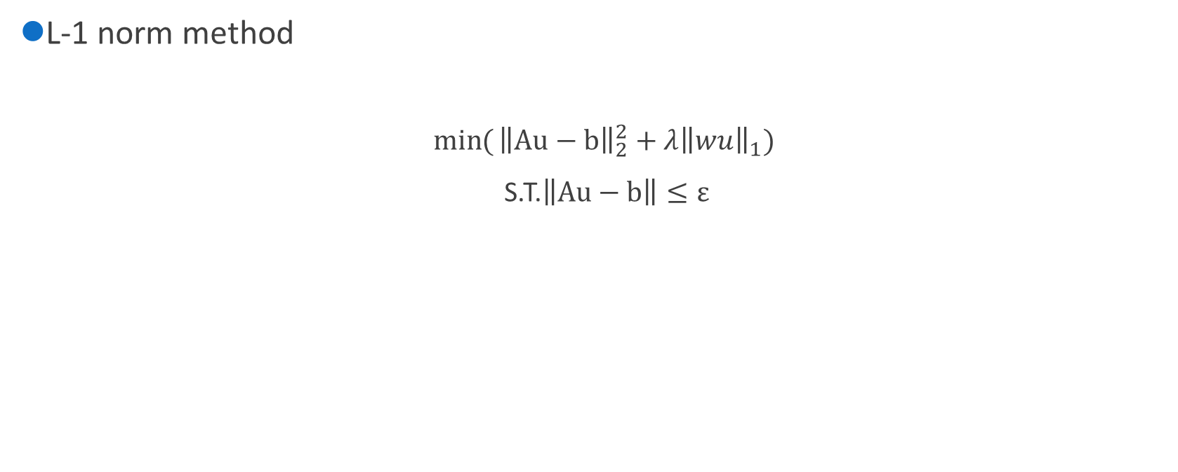
MCE
L-1 norm method
$\min{(}{\left\|Au−b\right\|}_{2}^{2}+λ{\left\|wu\right\|}_{1})$
S.T.$\left\|Au−b\right\|≤ε$

Slide 4
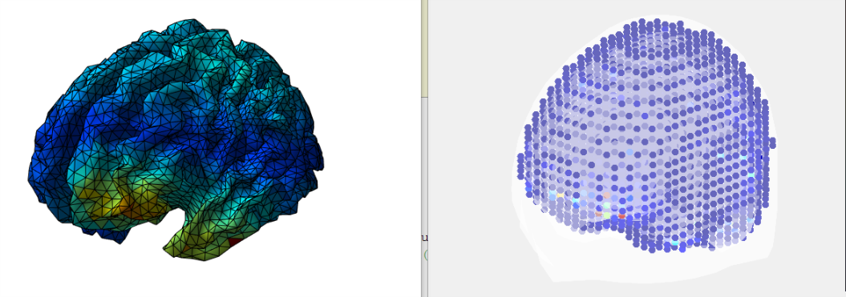
MCE
Results
Real data
2D
3D
Notes:
First I implement a real data, and this is the result. We can see the result of MCE matches the 2D localization result on the left, however, the following tests do not look this good.
The resolution of the source model is 8 mm and it has 10240 points.

Slide 5
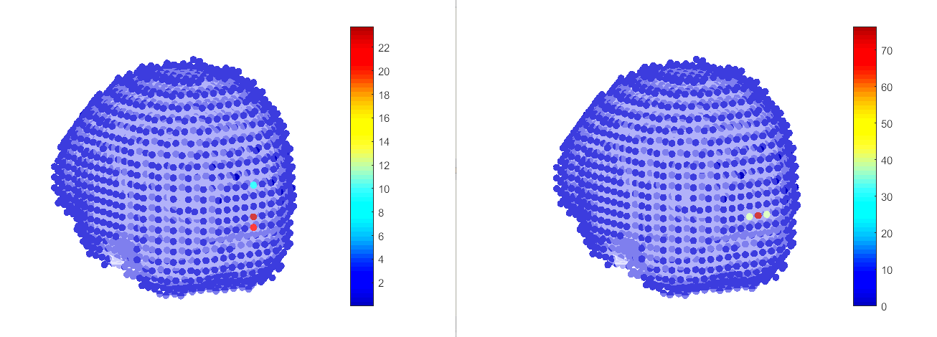
MCE
Results:
1 source on the surface
Result
Ground truth
DLE: 0mm
Notes:
And then I start to generate sources by myself to test this algorithm. First I generate one source on the surface of the brain. As we can see in the picture, when there is one source on the surface of the brain, MCE can localize the source accurately. The distance between the ground truth and the result is 0mm.
DLE means dipole localization error.

Slide 6
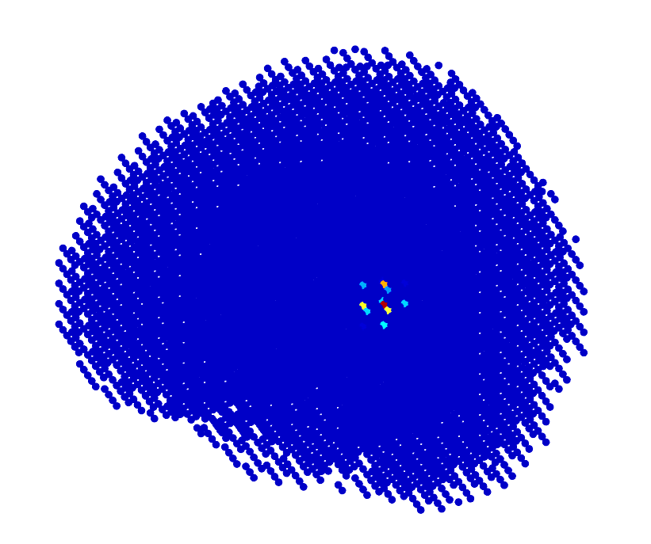
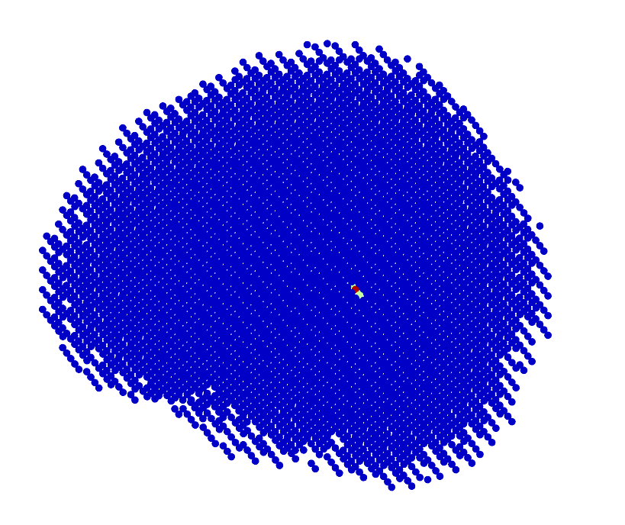
MCE
1 source in the deeper area
DLE: 0mm
Result
Ground truth
Notes:
After normalizing the lead field, the localization becomes very accurate. But due to the depth of the source, the result is not that sparse compared to the situation of source on the surface. But after using a threshold to see the localization result more clearly, we can see that the distance between the ground truth and the result is 0mm.
dipole localization error

Slide 7
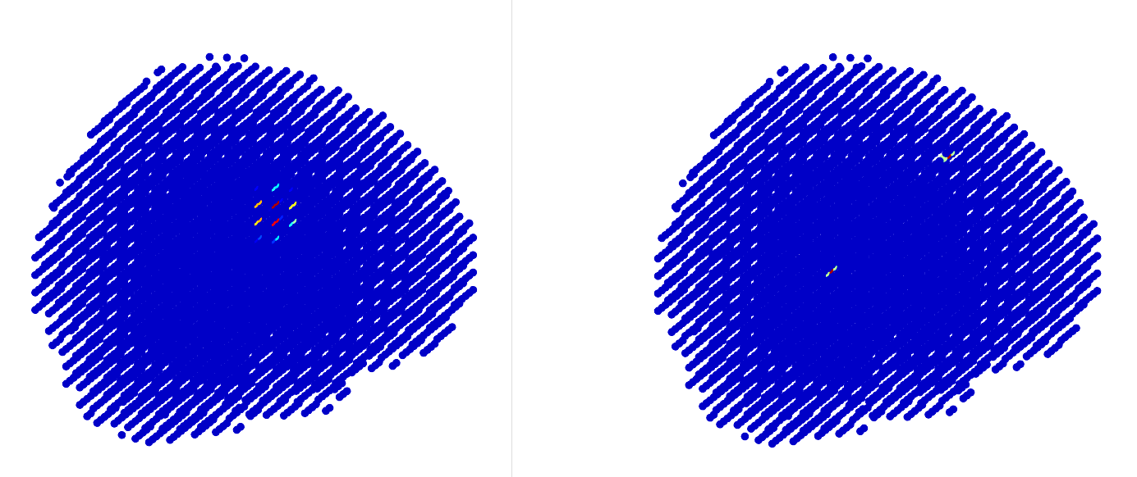
MCE
2 sources
Result
Ground truth
Notes:
Then I test 2 sources in the brain. As we can see, the result is totally wrong. And the position of the reconstructed result is in the middle of 2 ground truth sources. This is a typical bias of regularization method.

Slide 8
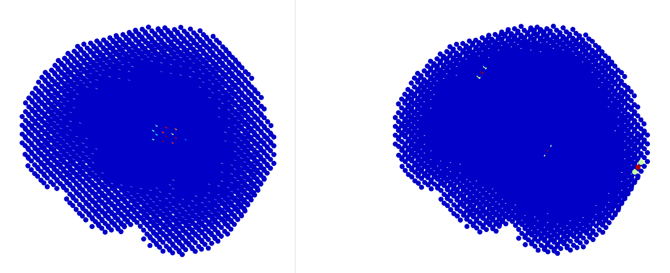
MCE
3 sources
Result
Ground truth
Notes:
And here is the test of three sources, the result is located in the middle of 3 sources, the bias is similar to the 2 sources situation.

Slide 9
Problems^{[1]}
The depth bias:
Common in regularization methods
Some methods are not affected (such as sLORETA)
Deep-lying sources masked by superficial ones
Notes:
Lucka F. Hierarchical Bayesian Approaches to the Inverse Problem of EEG/MEG Current Density Reconstruction[J]. 2011.
Mathematic analysis have not been undertaken.
Many methods recover the source close to the sculpt.
According to the paper I read, the reason the bias in regularization methods features in 2 issue, one is called the depth bias. It is a common bias in regularization methods. But sLORETA method is not affected by it.
Another reason is that the deep lying sources are masked by the superficial ones, which means that if we have a superficial source and a deep lying source, the result cannot show the deep source.

Slide 10
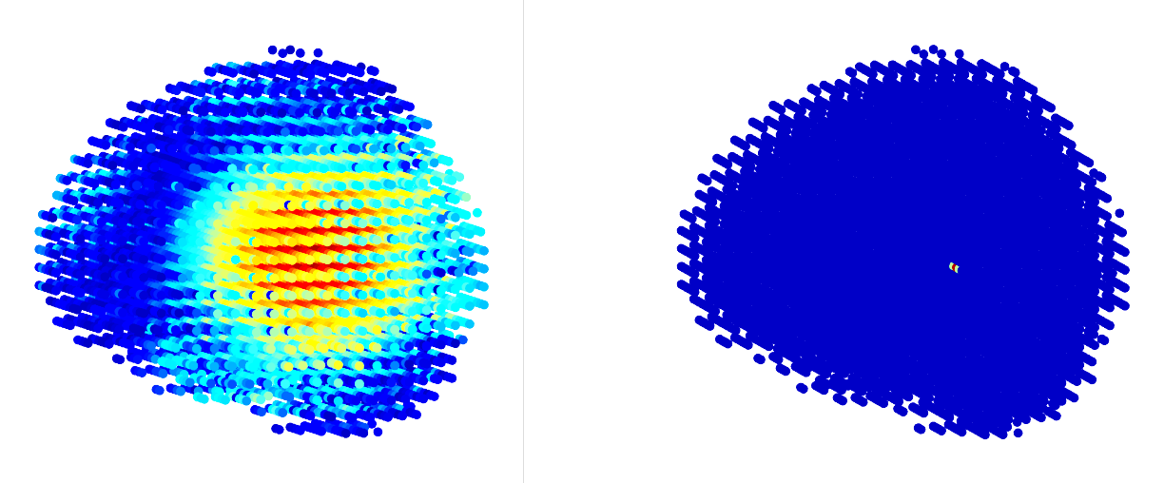
sLORETA
Single source:
DLE: 0.8mm
Result
Ground truth
Notes:
This is my test on sLORETA. The method does not show depth bias, although it is not sparse.

Slide 11
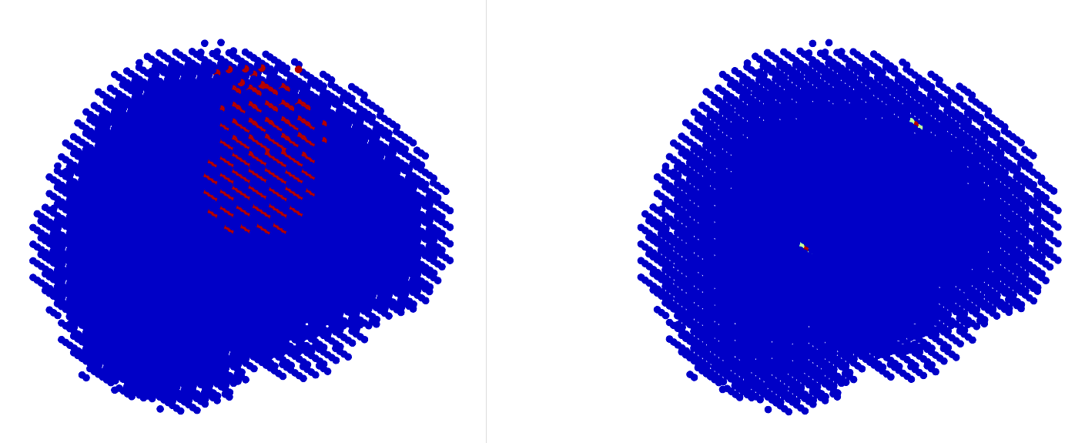
sLORETA
2 sources:
Result
Ground truth
Notes:
But in the 2 sources condition, one superficial and another is deep. The result cannot show the deep one.

Slide 12
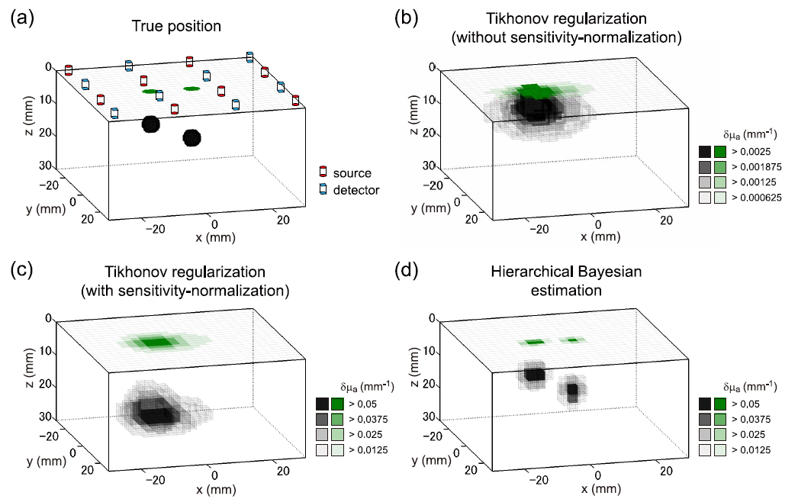
Problems^{[2]}
Problems^{[1]}
Notes:
This picture shows the results of a simulation of source localization. They use both regularization methods and Bayesian methods to deal with it and the results show that the regularization method is not accurate when dealing with multi-sources in deeper area. And Bayesian method performs very well.
This is a simulation model, picture a shows the ground truth, and we can see that the regularization method cannot separate 2 sources but the Bayesian method can.
Shimokawa T, Kosaka T, Yamashita O, et al. Hierarchical Bayesian estimation improves depth accuracy and spatial resolution of diffuse optical tomography[J]. Optics Express, 2012, 20(18):20427-46

Slide 13
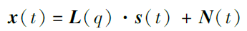
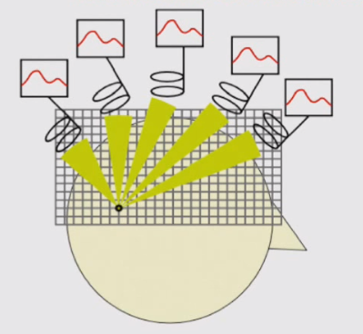
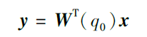
LCMV (Linearly Constrained Minimum Variance)
Principal
Spatial filtering
Notes:
Different from regularization methods, the idea of LCMV is beamforming which uses spatial filtering to calculate the source location. The algorithm aims to find a spatial filter in each source location q in the brain , as the W in the function. The output Y means the power of sources in the brain, which contains the information of the source location.
1997，Barry D. Van Veen,*

Slide 14
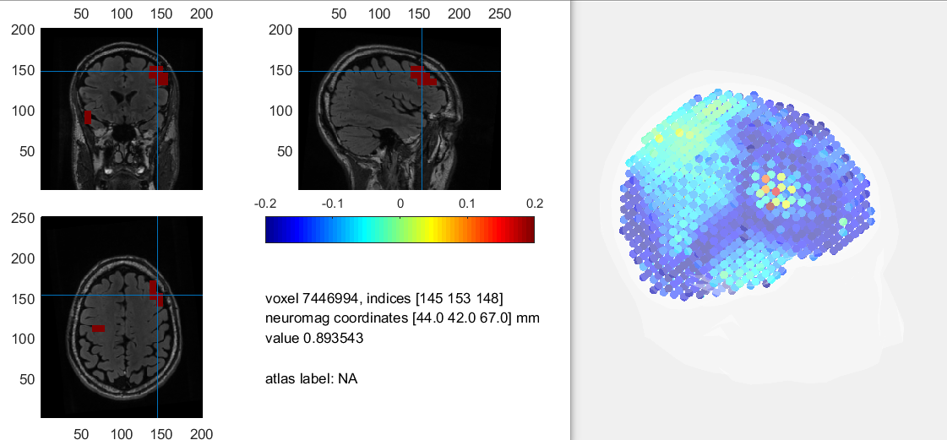
LCMV
Implementing a real dataset from fieldtrip:
Notes:
Also I implement this method.
This is the result of a real data which is download from fieldtrip and it can demonstrate the performance of LCMV. The results looks good. It seems that this is a good method in 3D model, and we need to do more tests on it.
The data is from the test of monitoring the movement when you press buttons with your hand.
8mm resolution, 7038 points inside the brain.

Slide 15
LCMV
LCMV has some special requirements on the data.
Pre-stimulus and post-stimulus data required
Cannot be used on a time point, should be used on a time series
Notes:
And there are still some drawbacks of LCMV. The first is that LCMV cannot be used on a single time point data but a time period data. It requires the data includes pre-stimulus and post-stimulus states, which makes it less useful. So I haven’t focus on it.

Slide 16
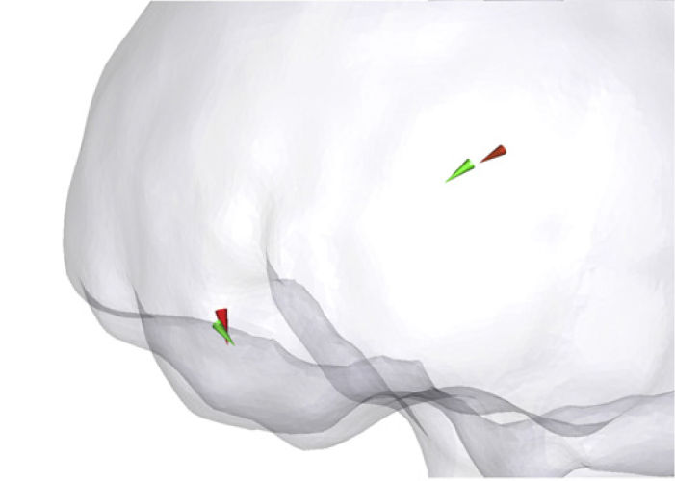
Results of Bayesian method (2 sources)
Green cones are ground truth.
Red cones are results.

Slide 17
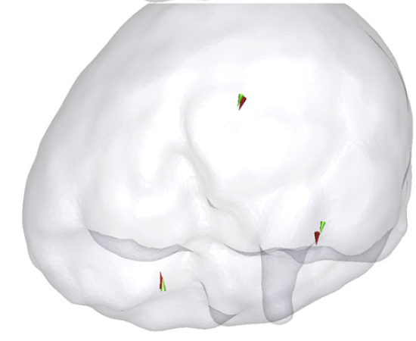
Results of Bayesian method (3 sources)
Green cones are ground truth.
Red cones are results.

Slide 18
Conclusion
MCE has good results in single source detaction.
Bayesian method is said to be the best method in 3D model source localization^{[1]}.

Slide 19
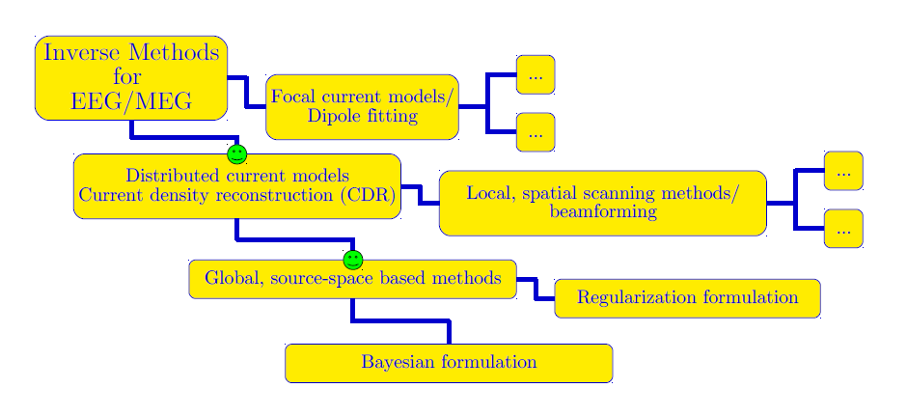

Slide 20
Next Step
Complete literature review
Implement Bayesian methods
Figure out the mathematical explanation of the bias of regularization methods

Slide 21
Thanks for your time

Slide 22
References
Lucka F. Hierarchical Bayesian Approaches to the Inverse Problem of EEG/MEG Current Density Reconstruction[J]. 2011.
Shimokawa T, Kosaka T, Yamashita O, et al. Hierarchical Bayesian estimation improves depth accuracy and spatial resolution of diffuse optical tomography[J]. Optics Express, 2012, 20(18):20427-46.
Van Veen B D, Van Drongelen W, Yuchtman M, et al. Localization of brain electrical activity via linearly constrained minimum variance spatial filtering[J]. IEEE transactions on bio-medical engineering, 1997, 44(9):867.

Slide 23
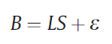
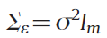
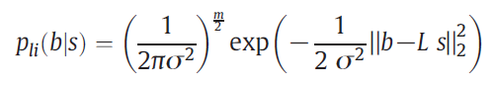
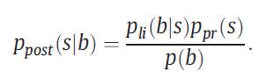
Hierarchical Bayesian Method
Likelihood model:
B and S are the random variables.
Measurement noise: (m is the number of sensors)
Likelihood density:
Bayes' rule:

Slide 24
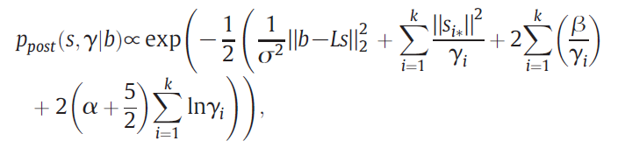
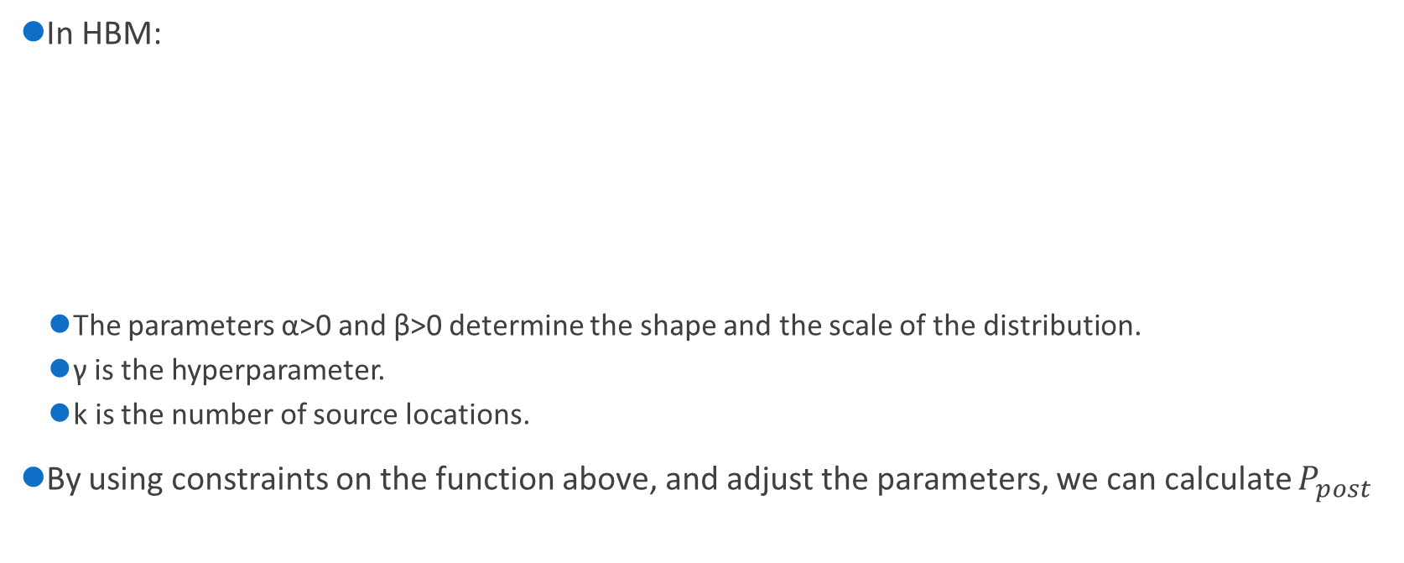
Hierarchical Bayesian Method
In HBM:
The parameters α>0 and β>0 determine the shape and the scale of the distribution.
γ is the hyperparameter.
k is the number of source locations.
By using constraints on the function above, and adjust the parameters, we can calculate $P_{post}$

Slide 25
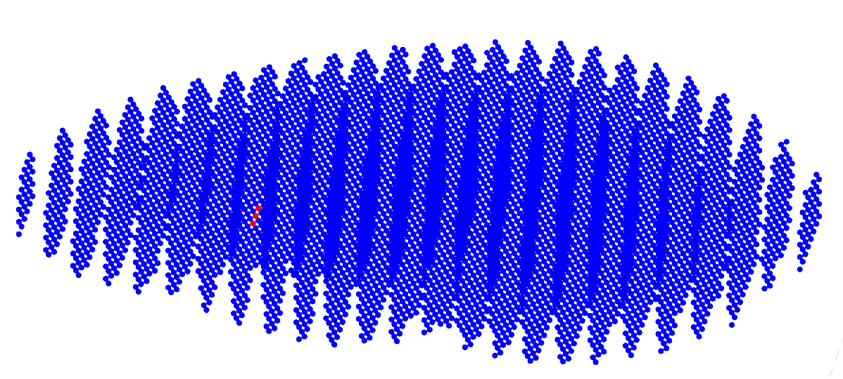
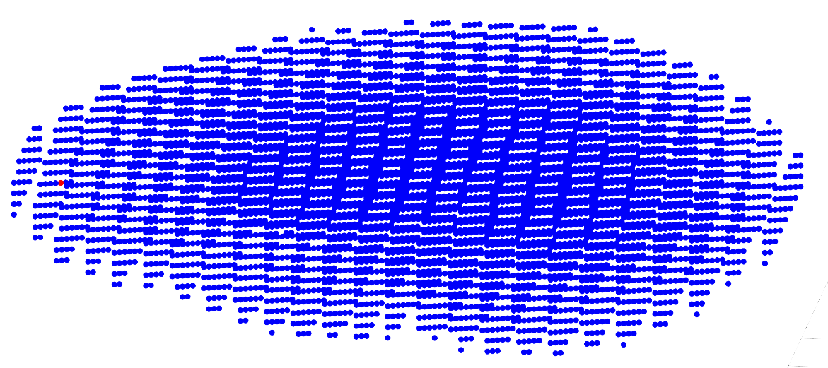
MCE
1 source in the deeper area (before normalizing the lead field)
result
source
Notes:
When it comes to one source in the deeper area of the brain, the localization becomes inaccurate. And after reading some papers, I found that normalizing the lead field can eliminate this problem.

Slide 26
Fieldtrip
Source localization steps:
Read data
Compute lead field matrix
Generate sources (optional)
Compute forward model
Apply inverse method
MNE, MCE, LCMV···
Plot results
Notes:
The first step is reading data, includes source model, head model, electrodes positions and potentials.
If you don’t have real eeg data, you can generate the ground truth yourself, then compute the forward model to get the simulated electrodes potentials.

